Slide 1
Creating a Dashboard

Slide 2
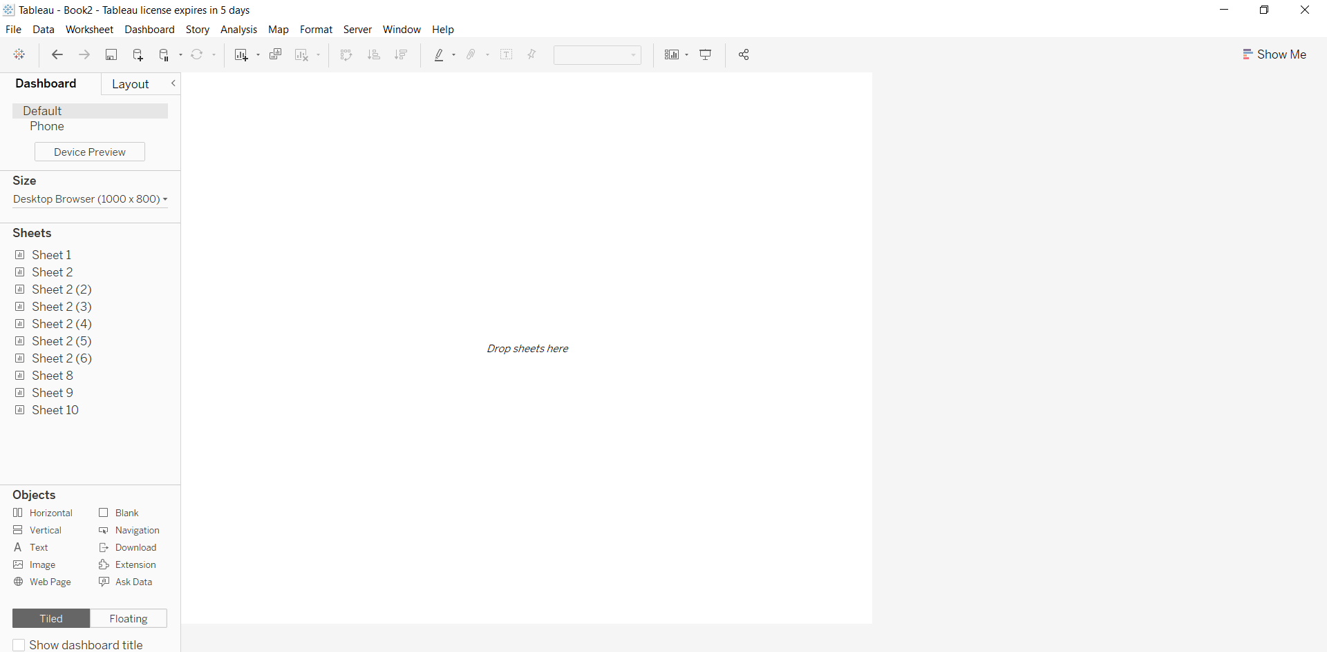
Build dashboard to show some insights.
Click on dashboard icon and then click on new dashboard in order to create dashboard

Slide 3
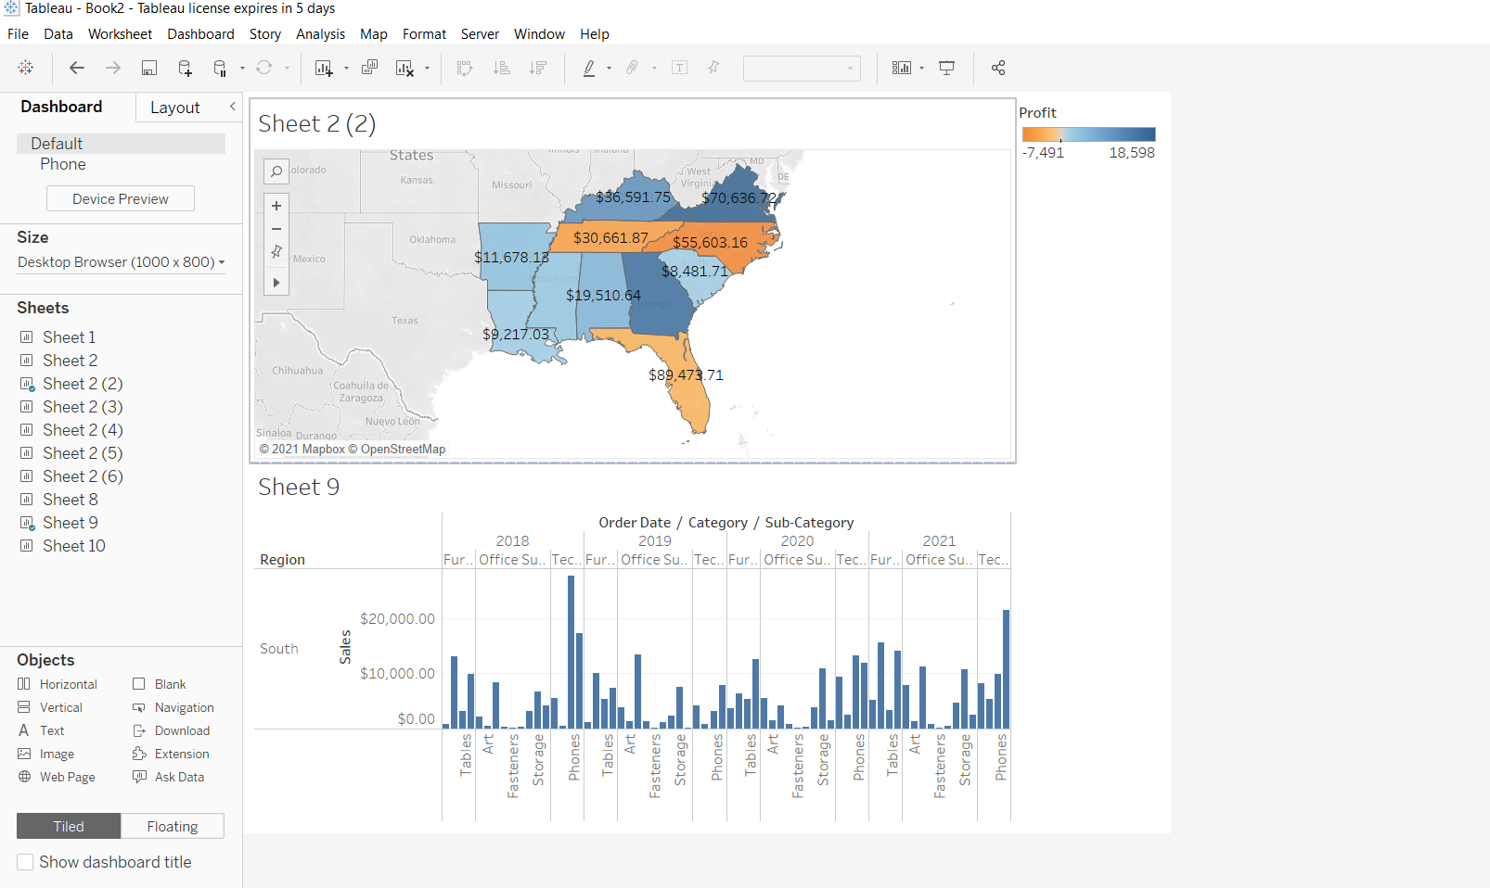

Slide 4
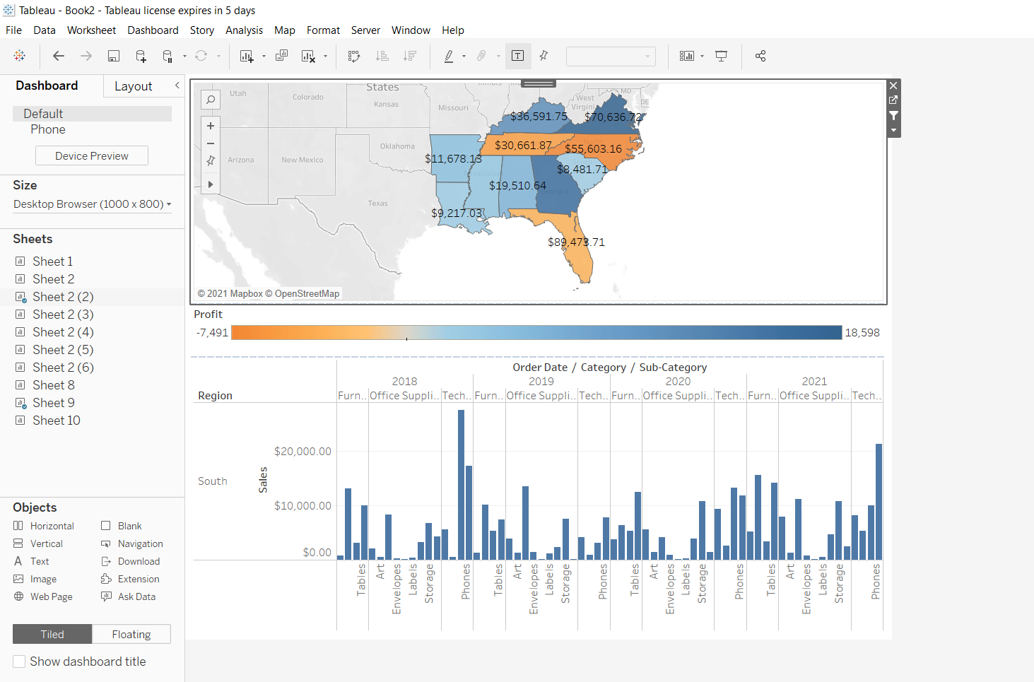

Slide 5
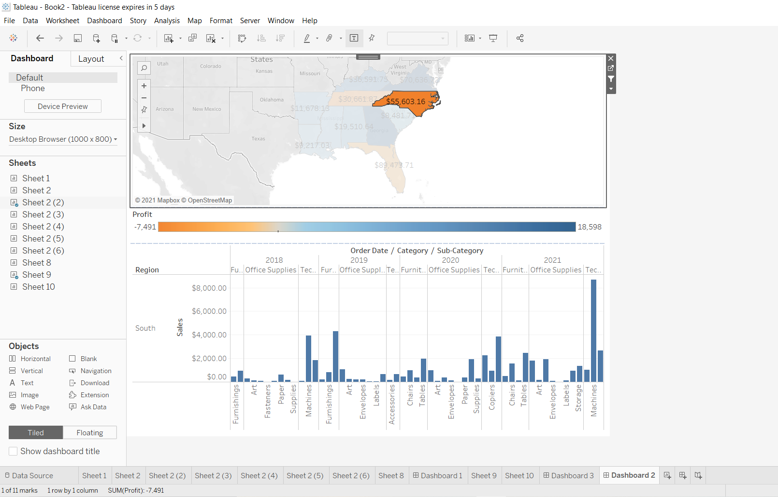
We remove the title by using hide title option and we drag the profit session at down

Slide 6
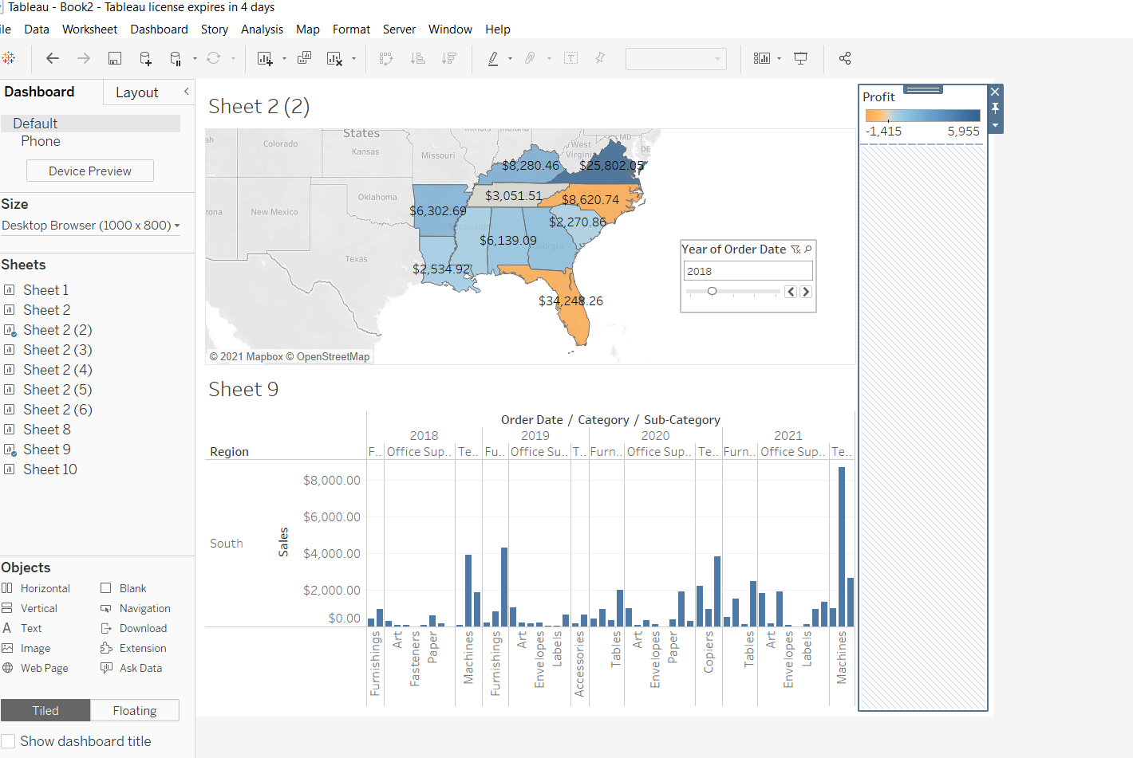
We can put slider for year to make it more interactive we can also use floating option

